Slide 1

MySpy
Brockton carnes
Cpsc 498 final presentation

Slide 2
Introduction: Agenda
Introduction
Proposal & Present Description
Project Background
GUI Overview
Demos
Conclusion
What I have
Challenges
What I can take away from this
Inspiration
Questions
Demos:
1)(Logger) How data is stored
2)Display previous logged data
3)Display data from November
4)Search for single word
5)Search for two words
6)Word Frequency

Slide 3
Introduction: Proposal & Present Description
Beginning of semester: “Create a spyware that uses keyloggers to detect what is typed into google browser. The software will also transmit this data to a graphical interface that will display what a user has searched for.”
Now: Interactive spyware that logs all data from a user while key logger is running and displays in a GUI. The display is responsible for opening, editing, saving and manipulating logged data in various ways.

Slide 4
Project Overview: Project Background
Interactive Spyware: Two primary components
Observes user keystrokes (Background): Python
Pynput Library: On press and on release
Time Library: Creating new txt files based upon date. Organizing file based on time of day
Manipulates recorded data in GUI (Display): Java and Java FX
Scene Builder: Smooth GUI creation based on Cascading Style Sheets. Auto generates XML files
OnMouseClicked Events: onMouseClicked="#searchData“
Auto generates methods within controller class
Easy access to widget ID’s

Slide 5
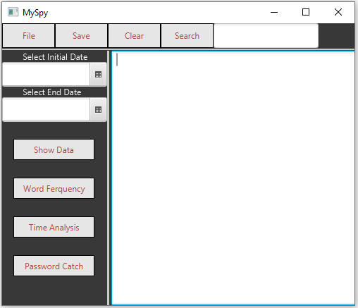
Introduction: GUI Overview
Widget Count: 14
8 Labels
2 DatePicker
2 Text’s
1 TextField
1 TextArea

Slide 6
Demo 1: (Logger) How Data Is Stored
Demonstration of keylogger
How files are constructed
File name: yyyy-mm-dd
Time and line structure:

Slide 7
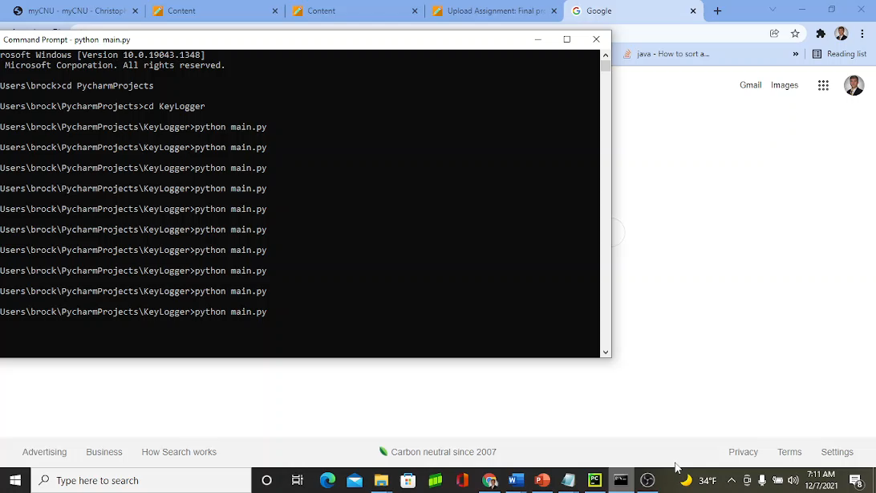

Slide 8
Demo 2: Display Previous Logged Data
Display logged data from previous demo
How to open a single file
How time intervals are concatenated
Edit the text field and save to a new file
Clearing fields and exit dialog

Slide 9
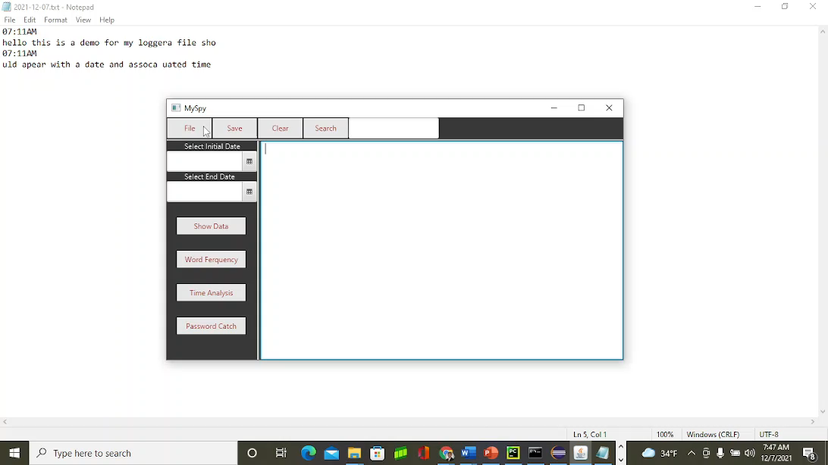

Slide 10
Demo 3: Display Data From November
Preview logged txt files from November
Select DatePicker’s to span data from month
Demonstrate logged data in TextArea

Slide 11
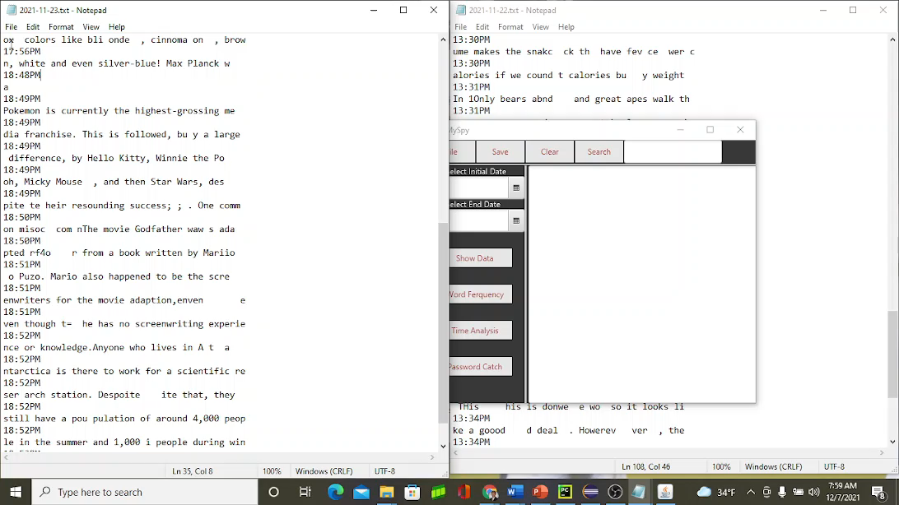

Slide 12
Demo 4: Search For Single Word
Display logged data from Nov – Present
Locate “demo” in txt file and TextArea
Display Dates and Times (only one occurrence)

Slide 13
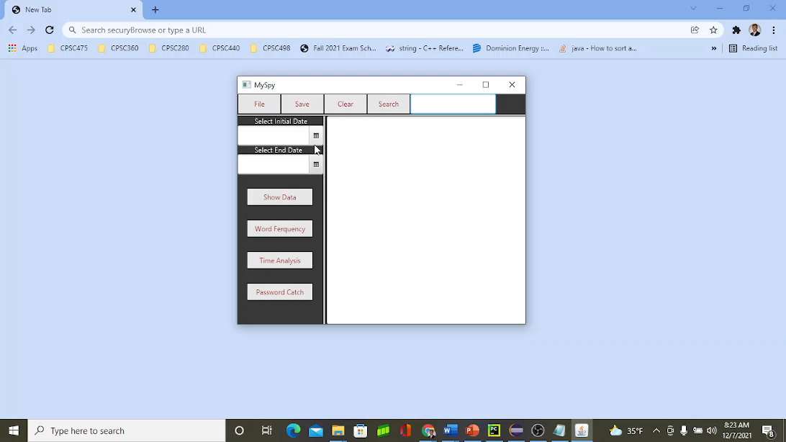

Slide 14
Demo 5: Search For Two Words
Search for word “this”
Create a deeper search for the word “protection”

Slide 15
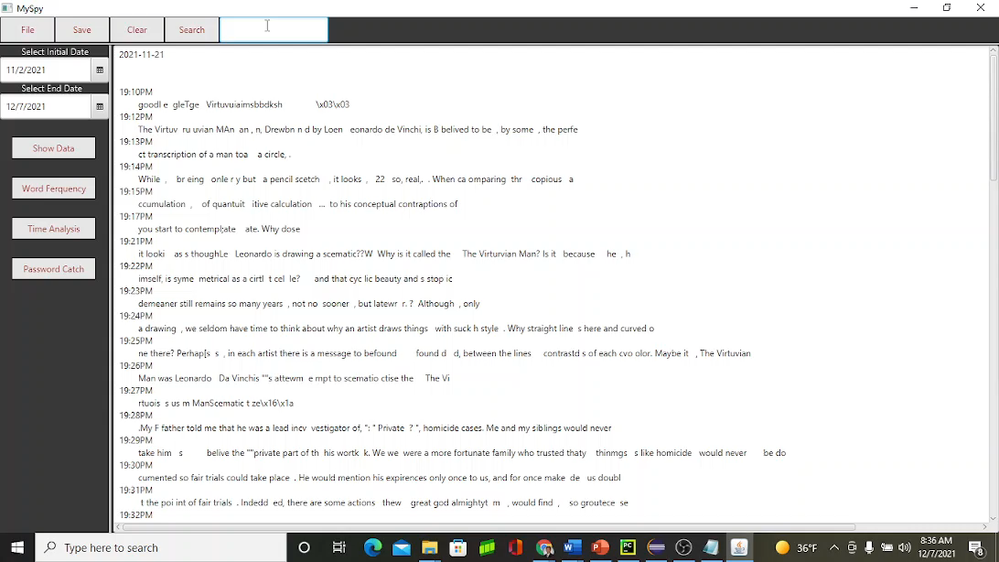

Slide 16
Demo 6: Word Frequency
Show another way to open a single file
Display word frequency for initial demo’s logged data
Notice all occurrences are 1 except for the word/letter “a”
Change the date to query data from beginning of November
Display the data and word frequency from these dates -> Notice the word “pas” (7)
Search the dates for the word “pas” and perform a deeper search for the word “login”
Save and exit

Slide 17
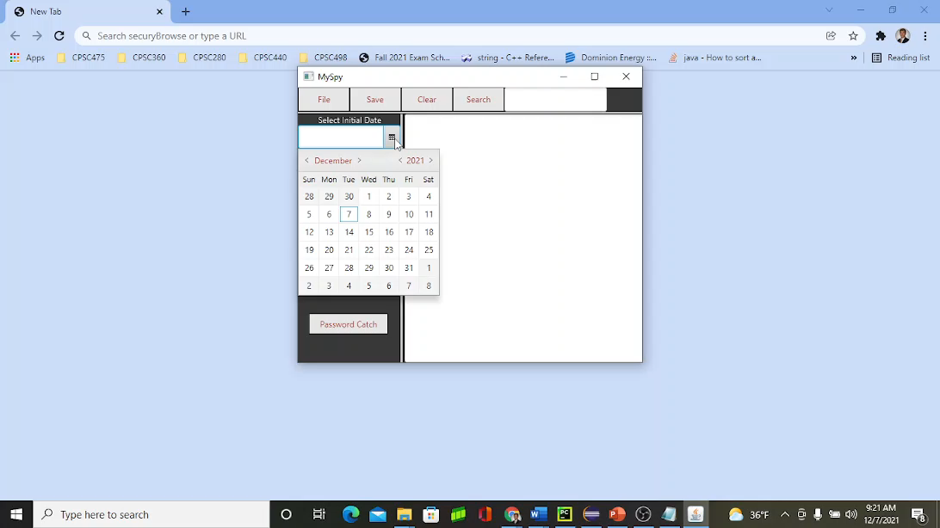

Slide 18
Conclusion: What I Have
Functional Key Logger:
Increments every 45 chars with time of day
Writes to File with associated date
Filters for quotation defaults and commands
Functional GUI :
Handles small to large amounts of data
Manipulates data
Missing Feature: Time Analysis (From Proposal)
Idea as I was making other labels
(Not in proposal)

Slide 19
Conclusion: Challenges
Time management
Working alone
Not reaching out for help
Getting hung up specific things -> Trying to multithread logger

Slide 20
Conclusion: What I can take away from this
Increase in time management skills -> Working in increments of 4 Weeks (Sprint)
Increased ability to present
Working through problems alone:
Not good practice to constantly ask for help in real world
Sometimes co workers won’t always have the answer for you

Slide 21
Conclusion: Inspiration
Personal work experience (NSWC)
Ethical hacking (CPSC428)
Increase Awareness

Slide 22
Questions

